Slide 1

Marathan parts – made to go the distance

Slide 2
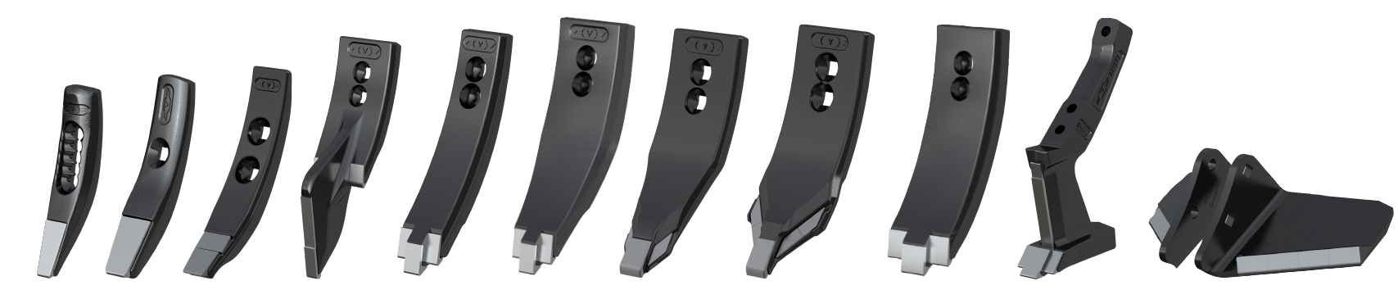
Marathon argumentation and comparisons

Slide 3
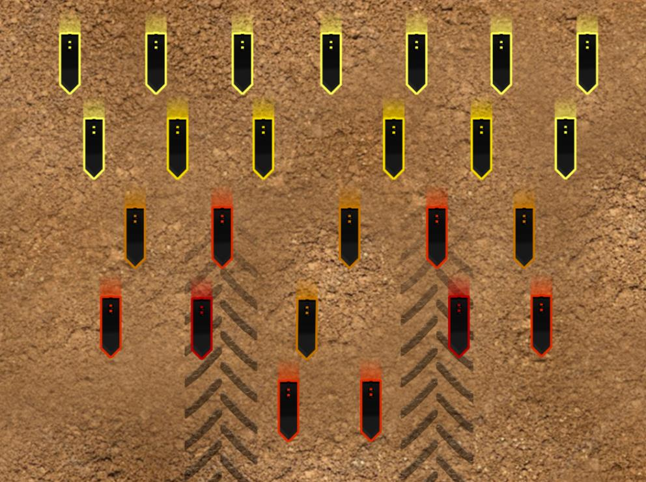
Different wear at different places
Less soil searching ability
More unstable run with increasing wear
Bigger impact when cultivating shallow

Slide 4
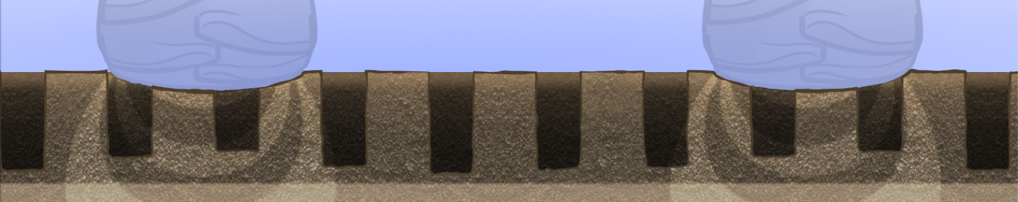
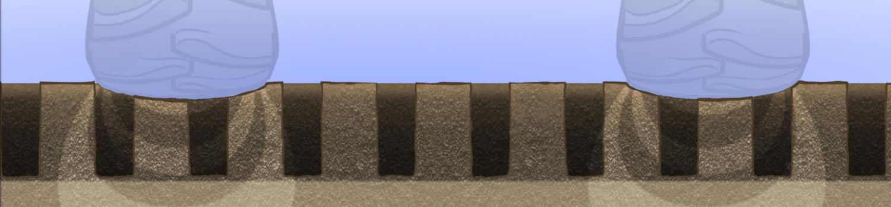
Marathon - all plants same conditions
Maximised yield potential
Normal points
at time of change
Extra compaction
Intended working depth
Extra compaction
Marathon
Intended working depth

Slide 5
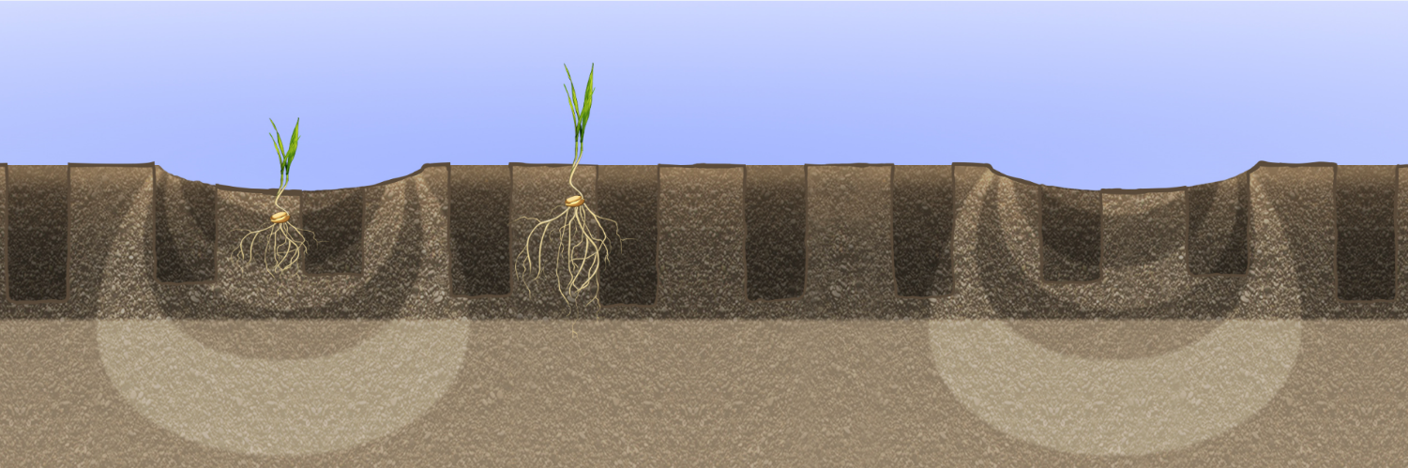
Plant impact different point wear
50% point makes 50% of the work!
Root development difference
Compaction – nutrient + water access problem

Slide 6
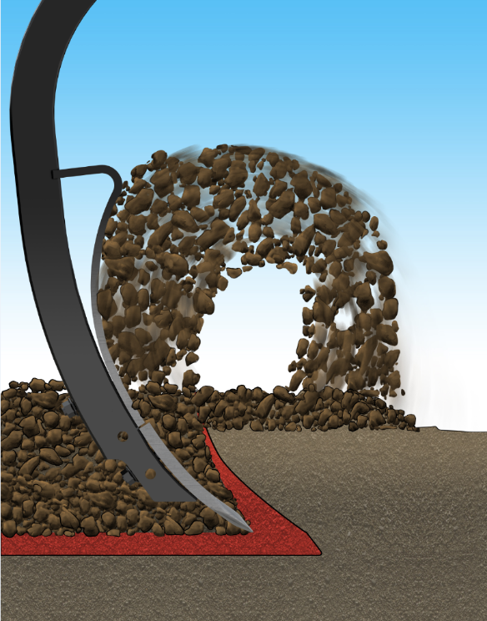
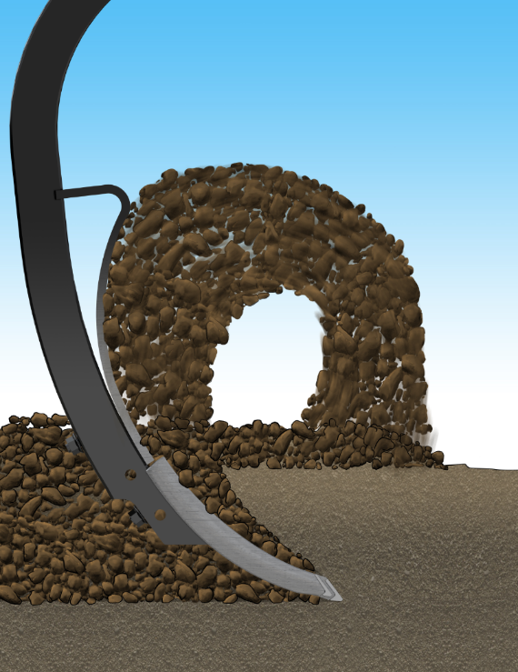
Marathon – maintained depth and mixing

Slide 7
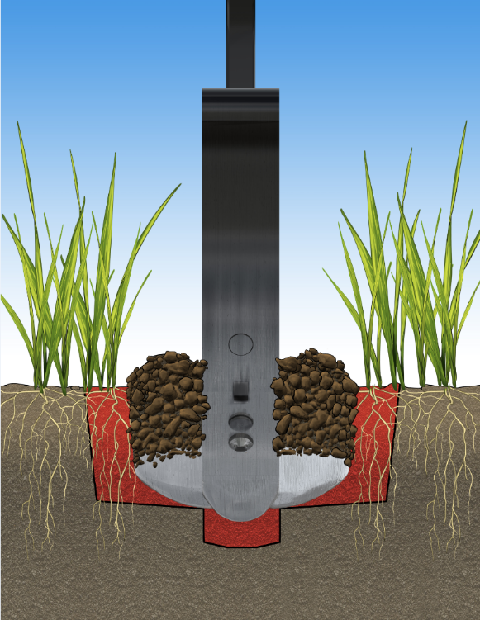
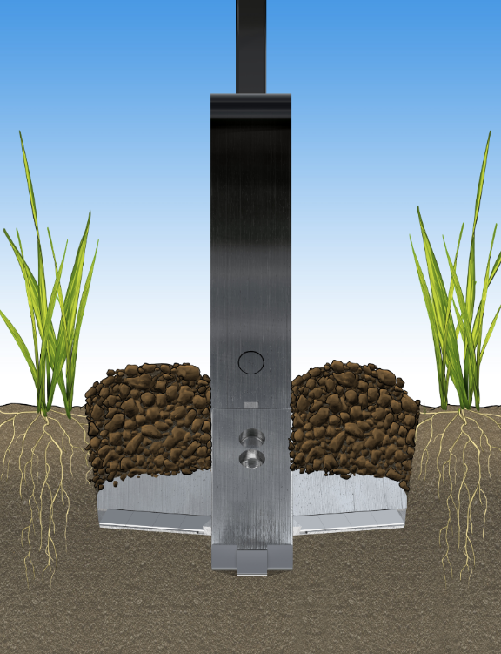
Marathon wing shares – always right width

Slide 8
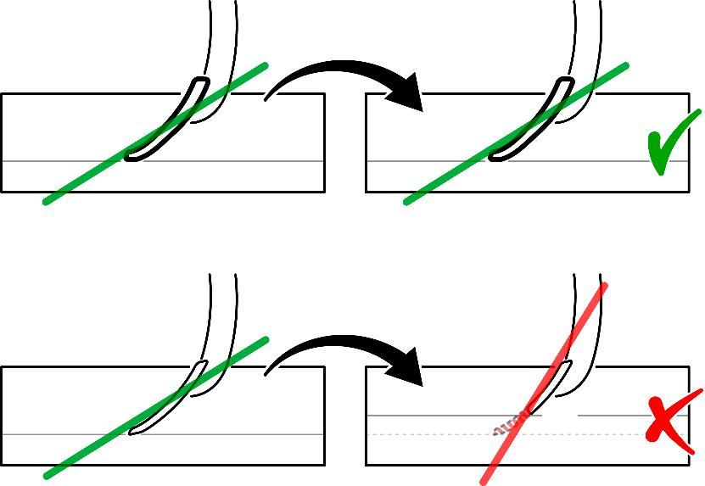
Marathon – saves fuel
Keeps a sharp point – moves easier through soil
Always optimal soil breaking angle
Increased wear changes angle

Slide 9
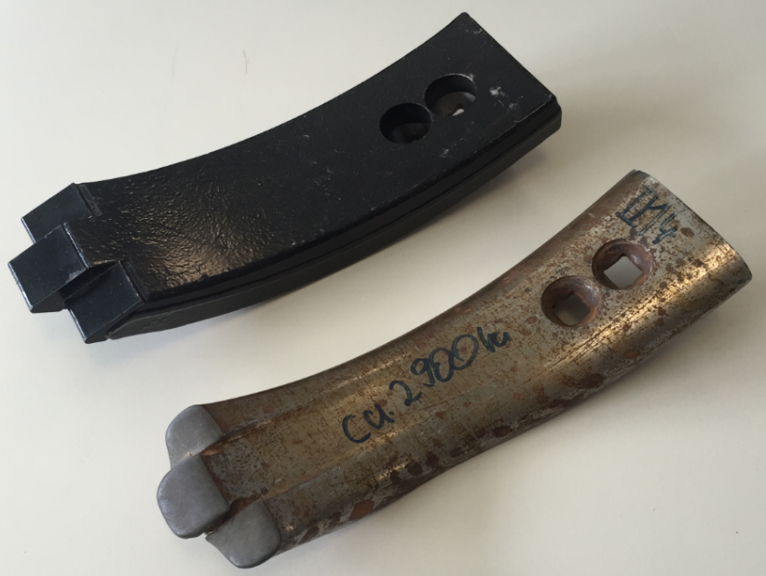
Test 2900ha Marathon point – shape maintained
App 6-9 x life time compared to conventional points

Slide 10
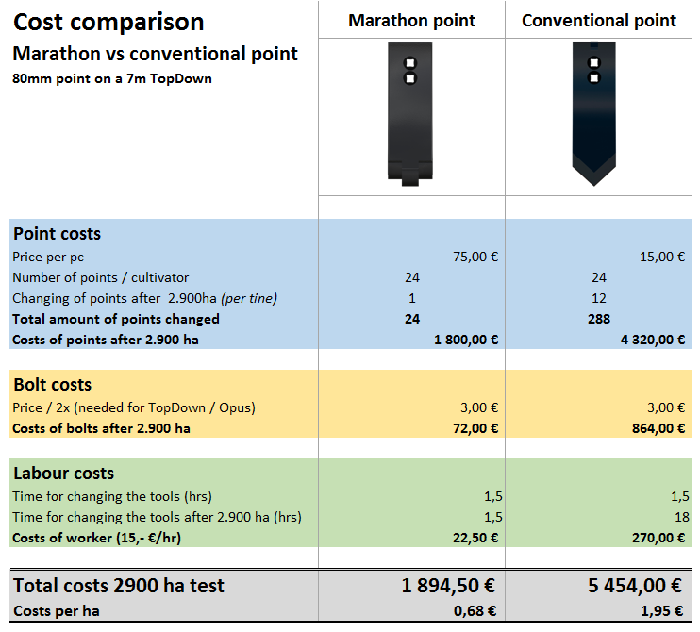

Slide 11
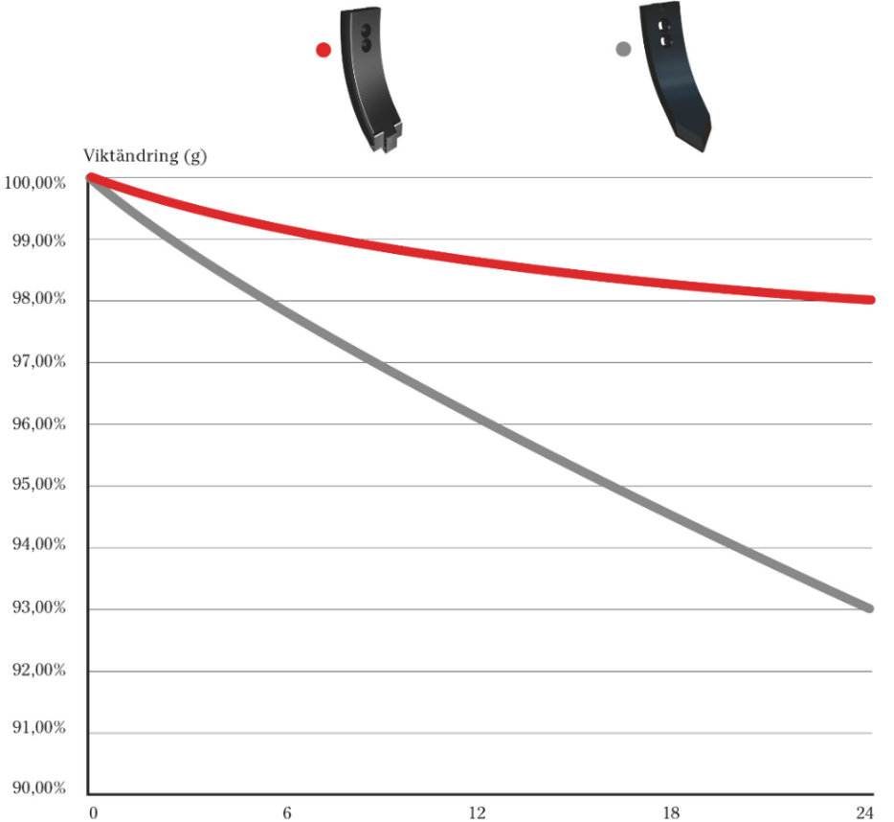
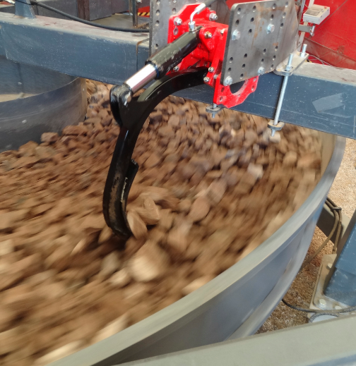
Less wear - longer life
Weight change (%)
Test by Väderstad
Time (h)
Tungsten has approxomatley 10 times the wear resistance of hardox steel!

Slide 12
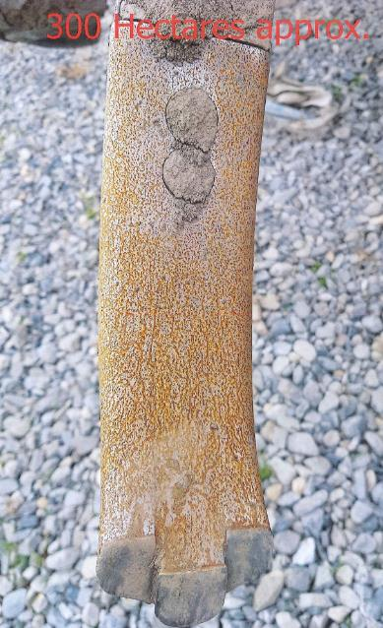
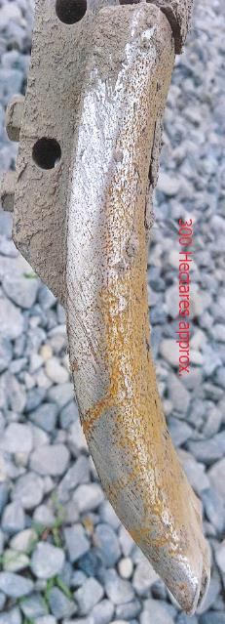
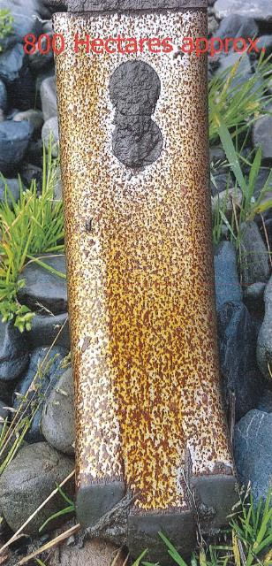
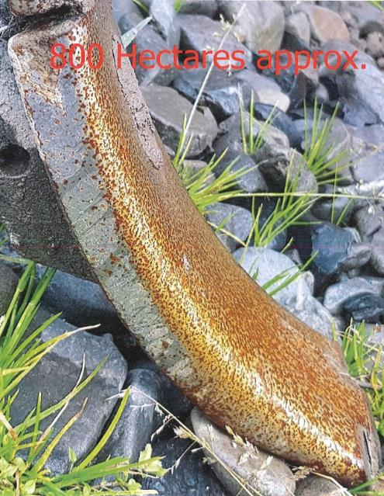
New Zealand wear pattern
300ha
800ha

Slide 13
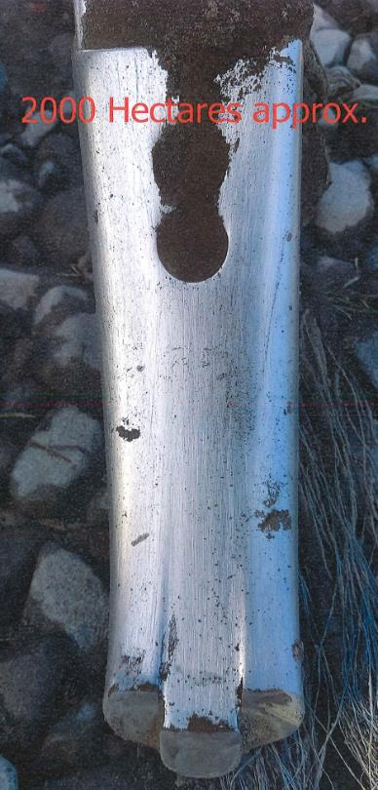
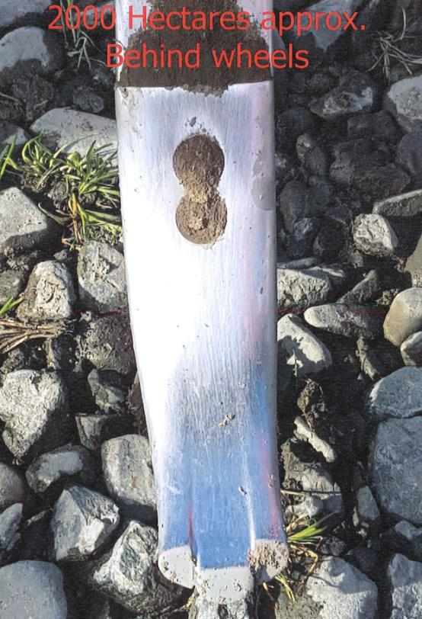
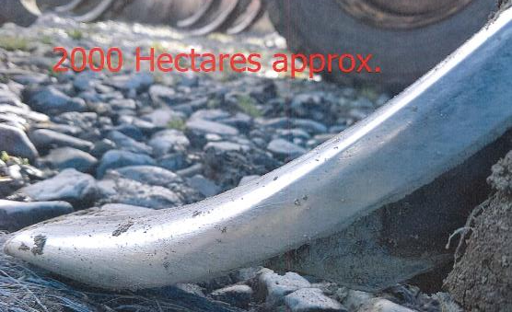
New Zealand wear pattern 2000ha

Slide 14
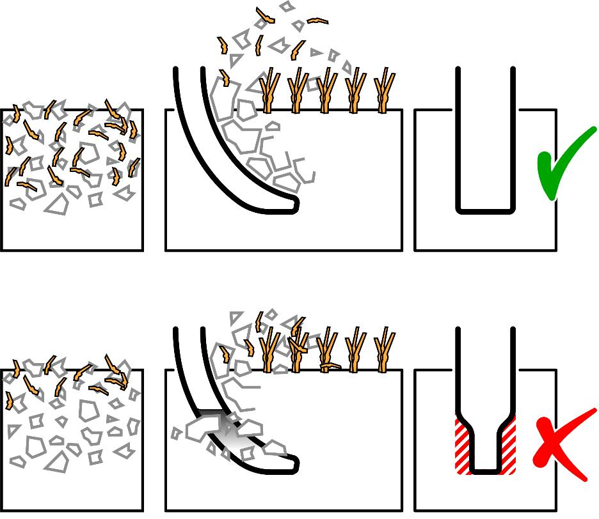
Maintained point width - maintained soil flow and mixing

Slide 15
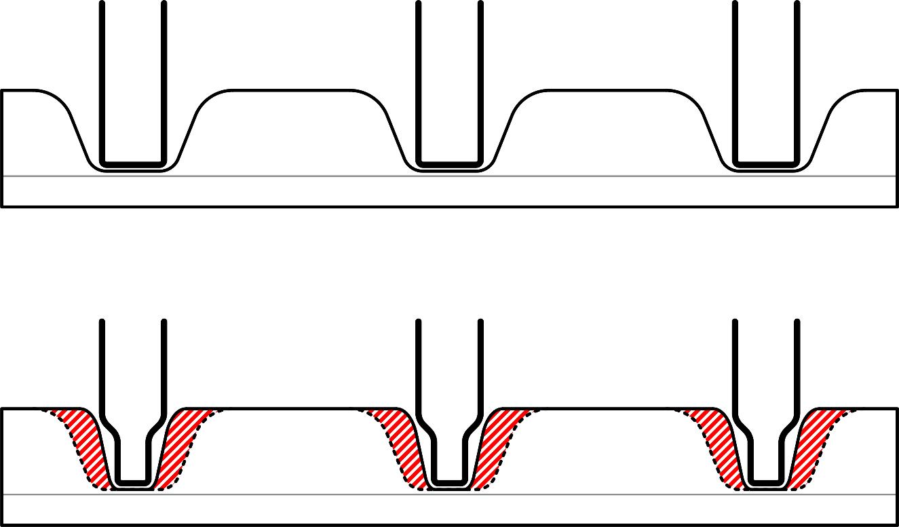
Maintained point width – maintained breaking and loosening

Slide 16
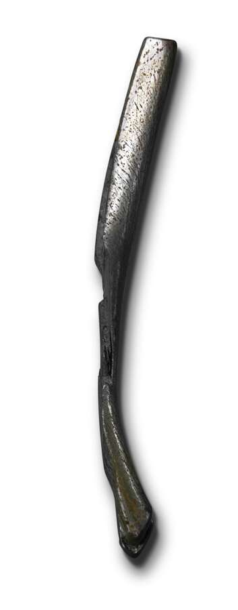
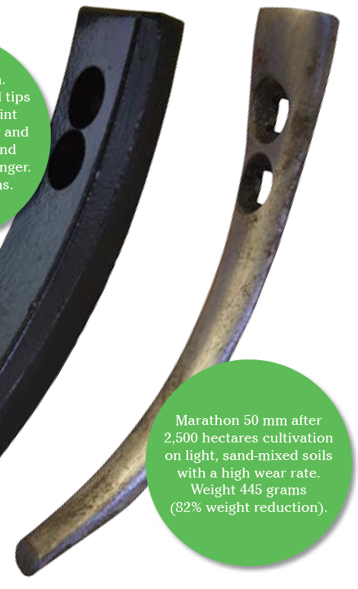
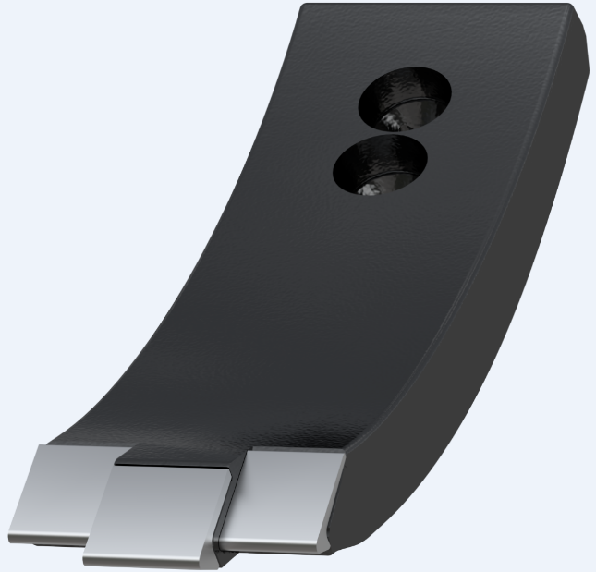
Perfect balance for maximum working life
Marathon
80 mm
Uniformly hardened at brazing, no crack risk
Perfect balance hard metal and steel

Slide 17
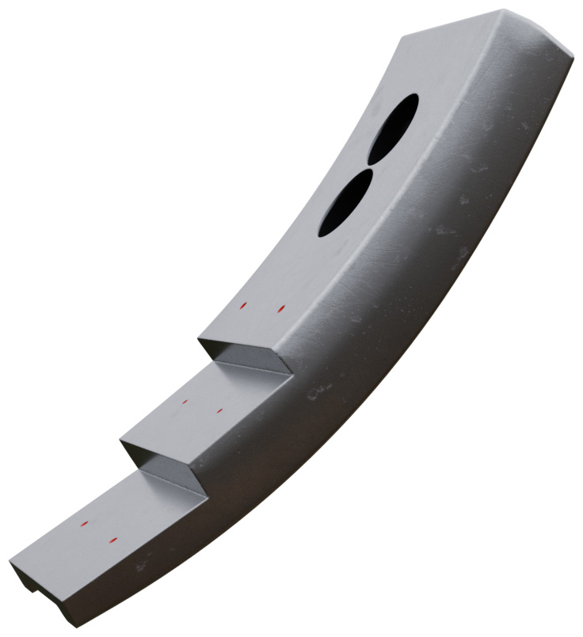
50 HRC Rockwell throughout -for maximum working life

Slide 18
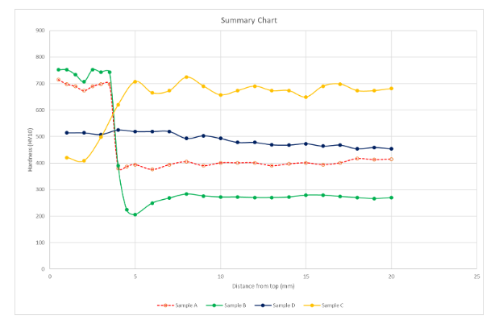
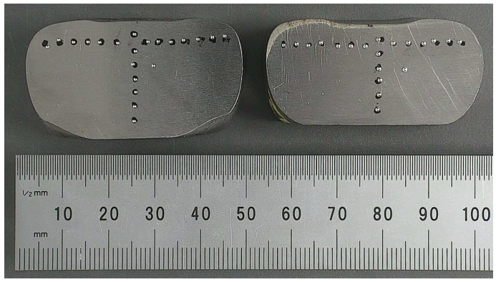
Even hardness – optimal long wear pattern
Measured from the top to bottom
A high, even hardness ensures maximum working life without risk of cracking
A good process gives an even value
Comparison with 3 competitors
Väderstad average 489 HV
≈ 49 Rockwell

Slide 19
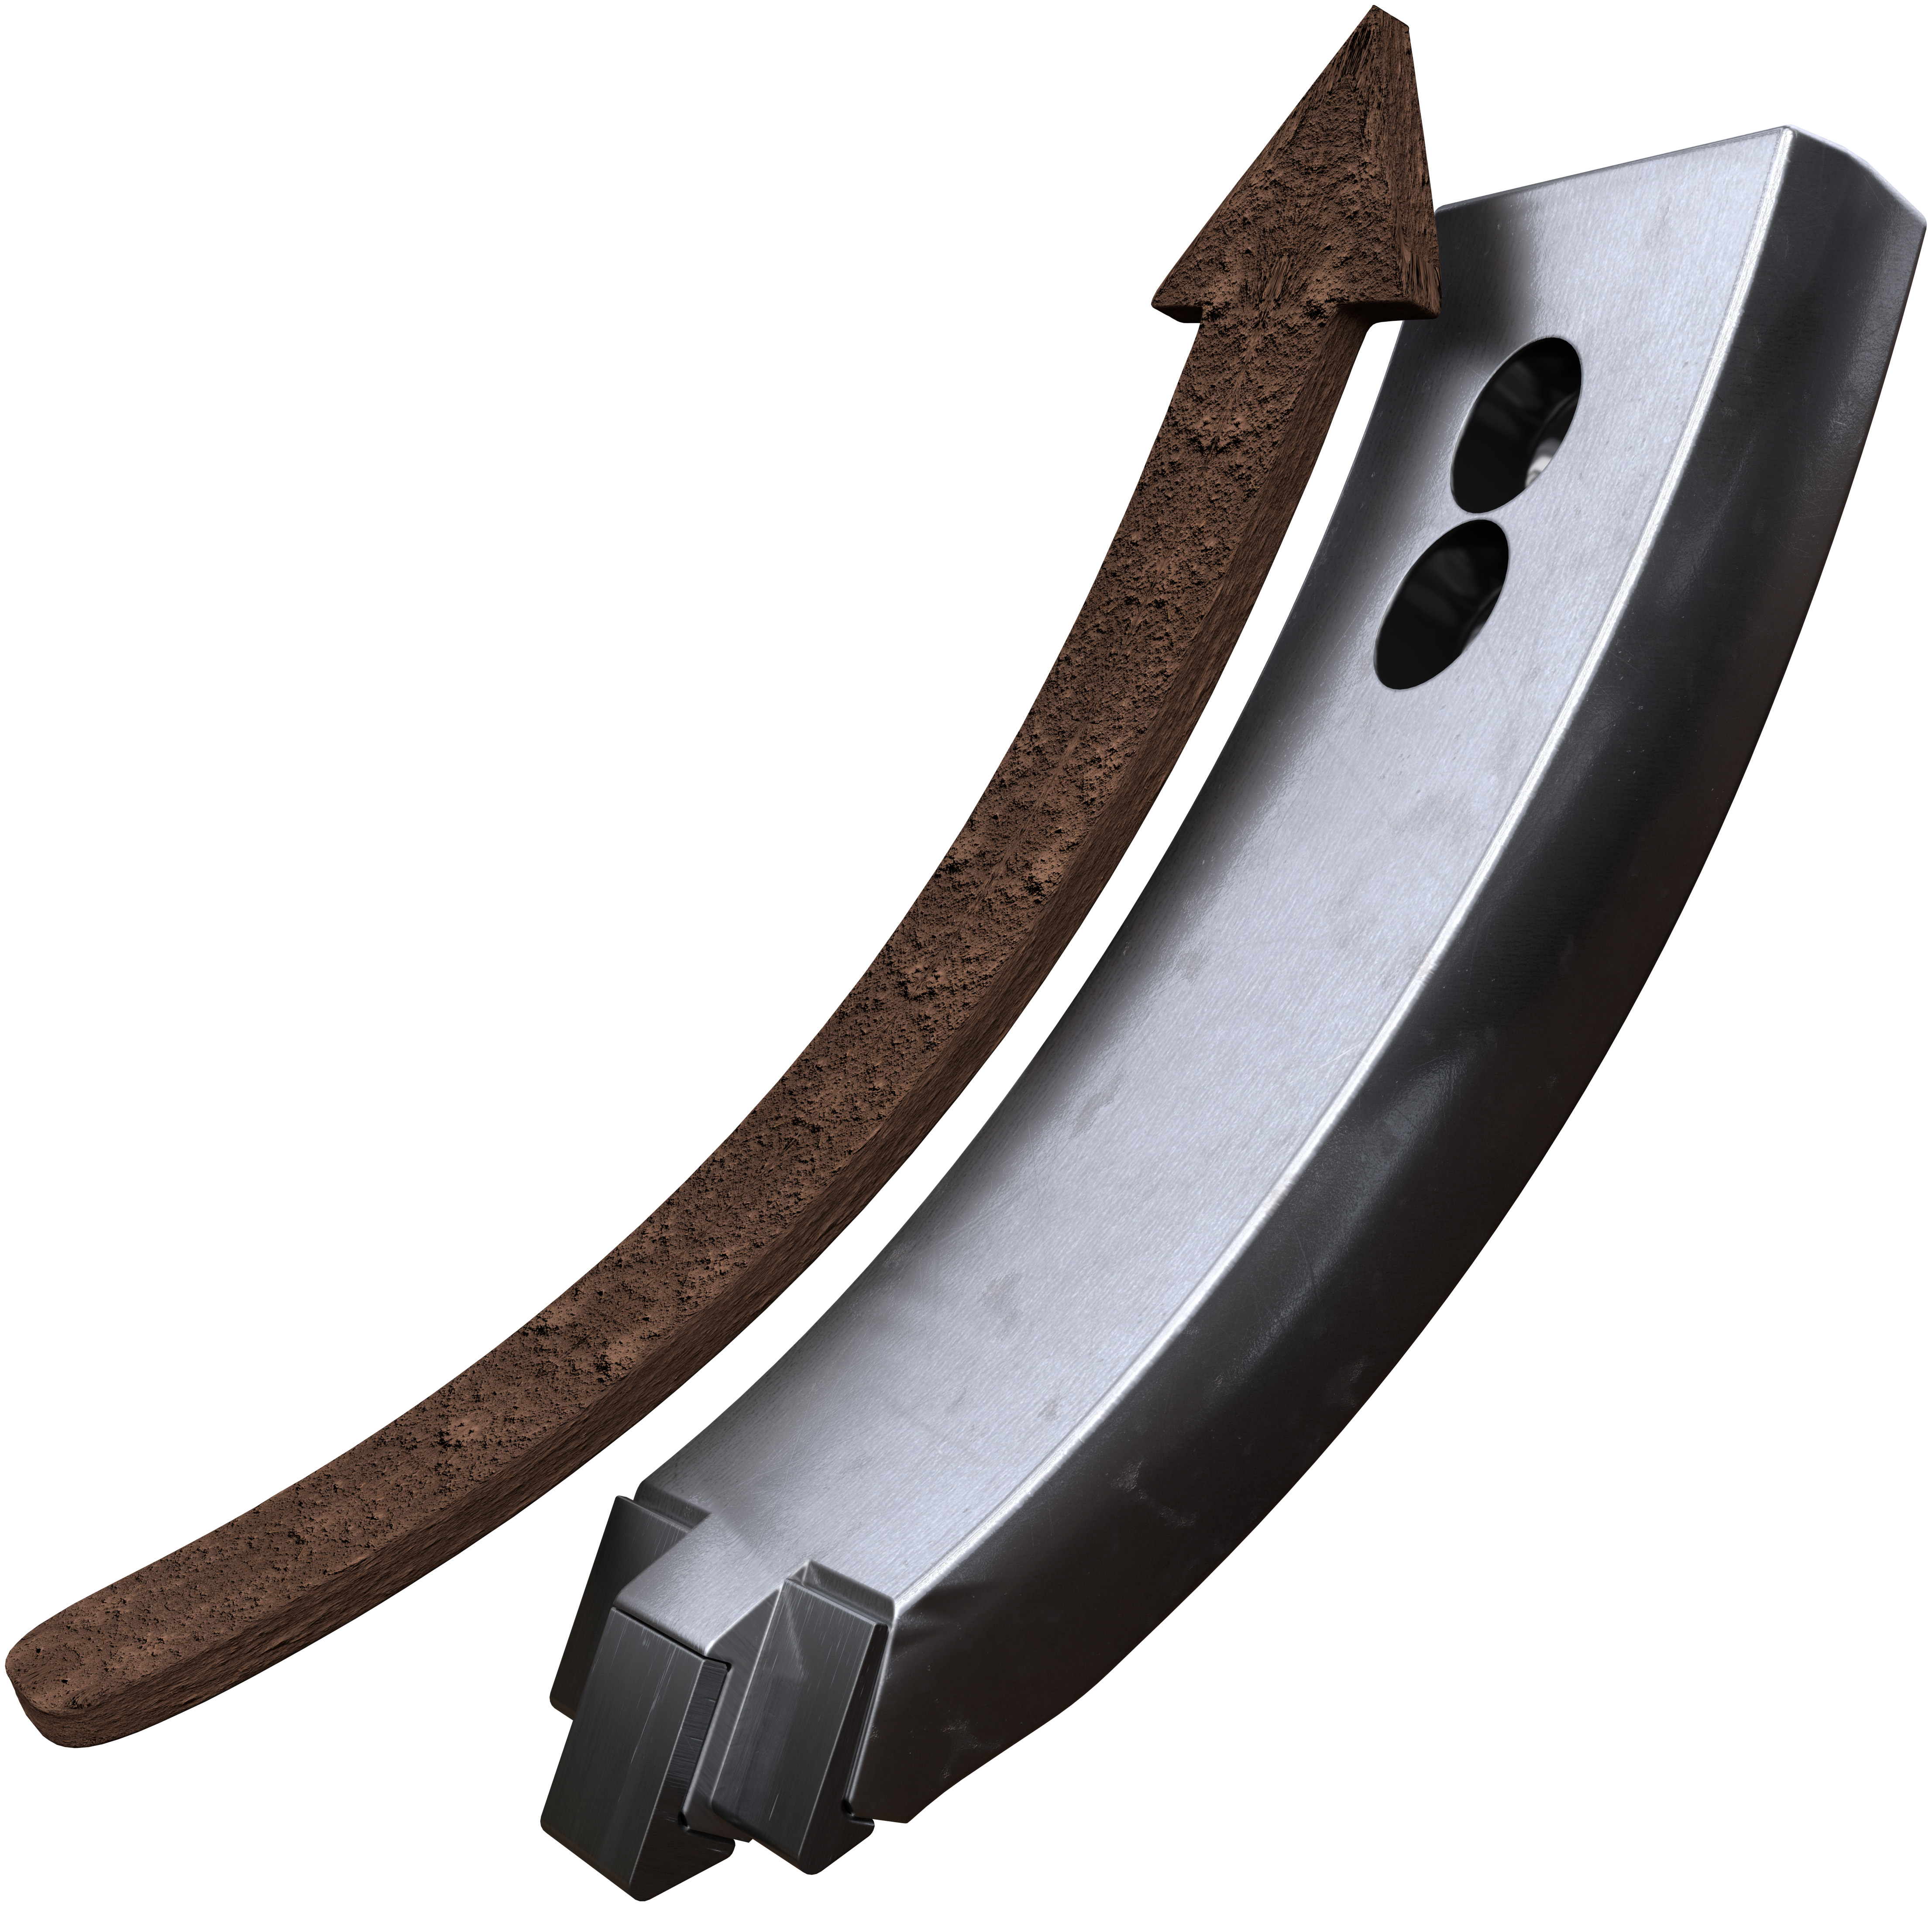
Flat point design
For maximum upward soil flow and
Minimum diesel consumption

Slide 20
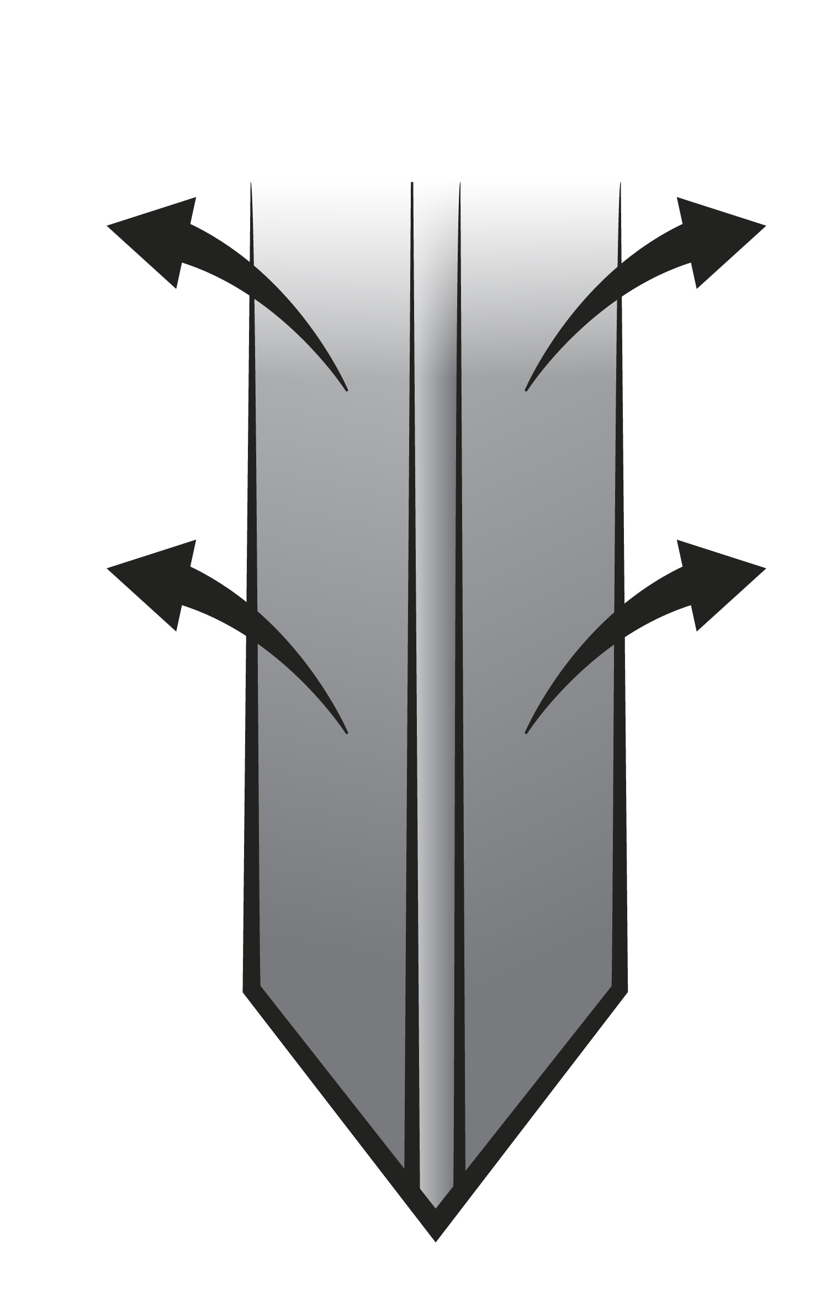
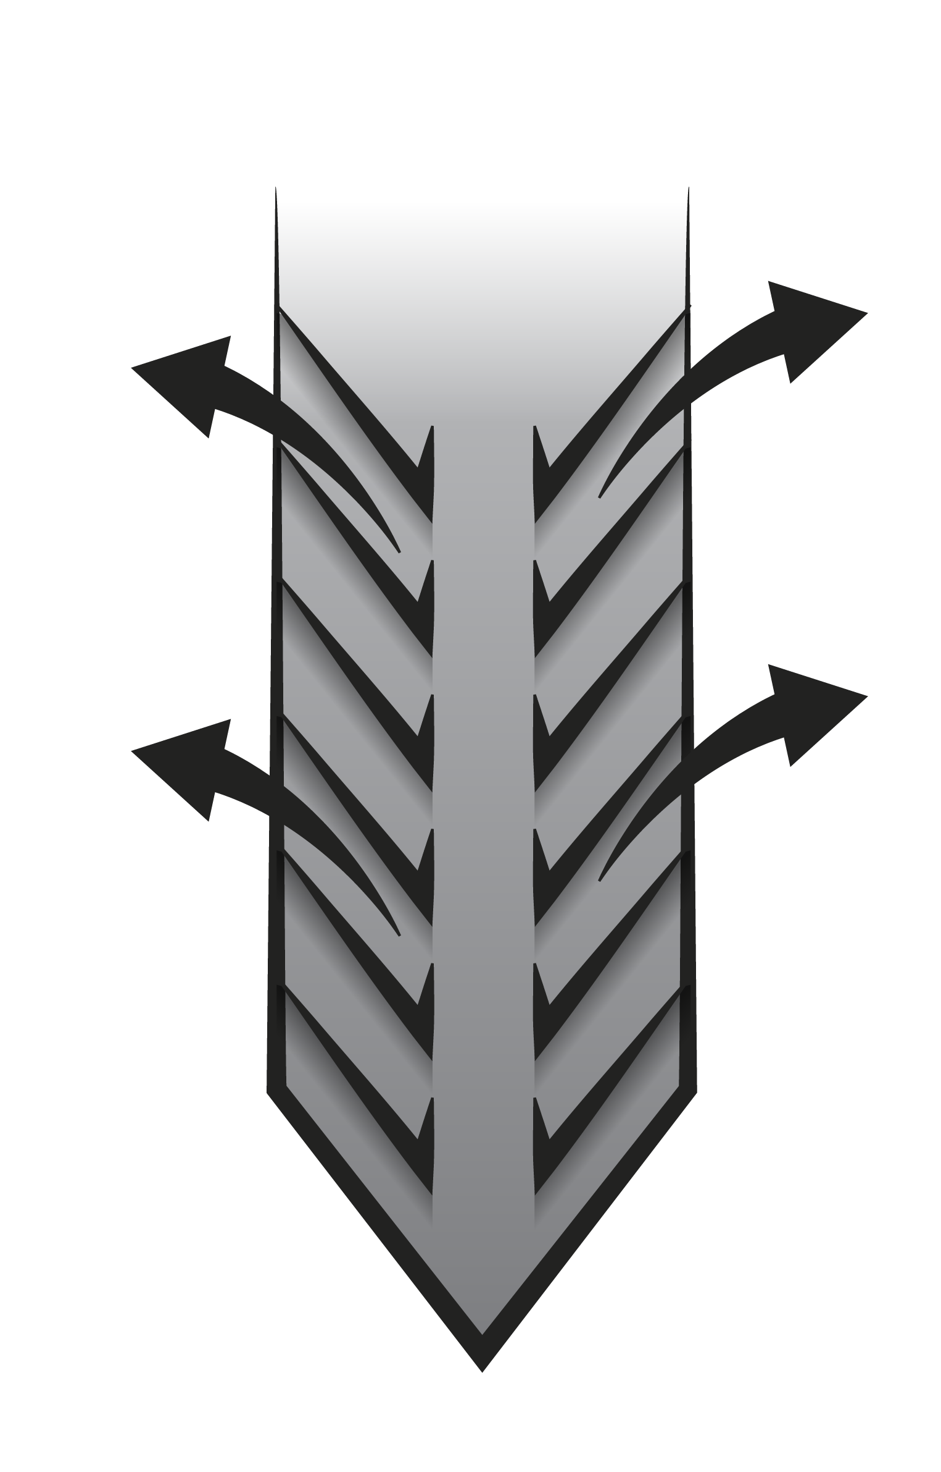
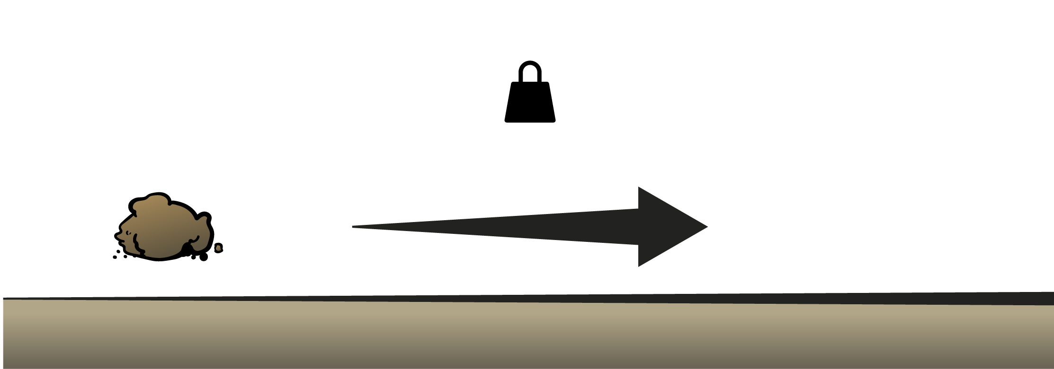
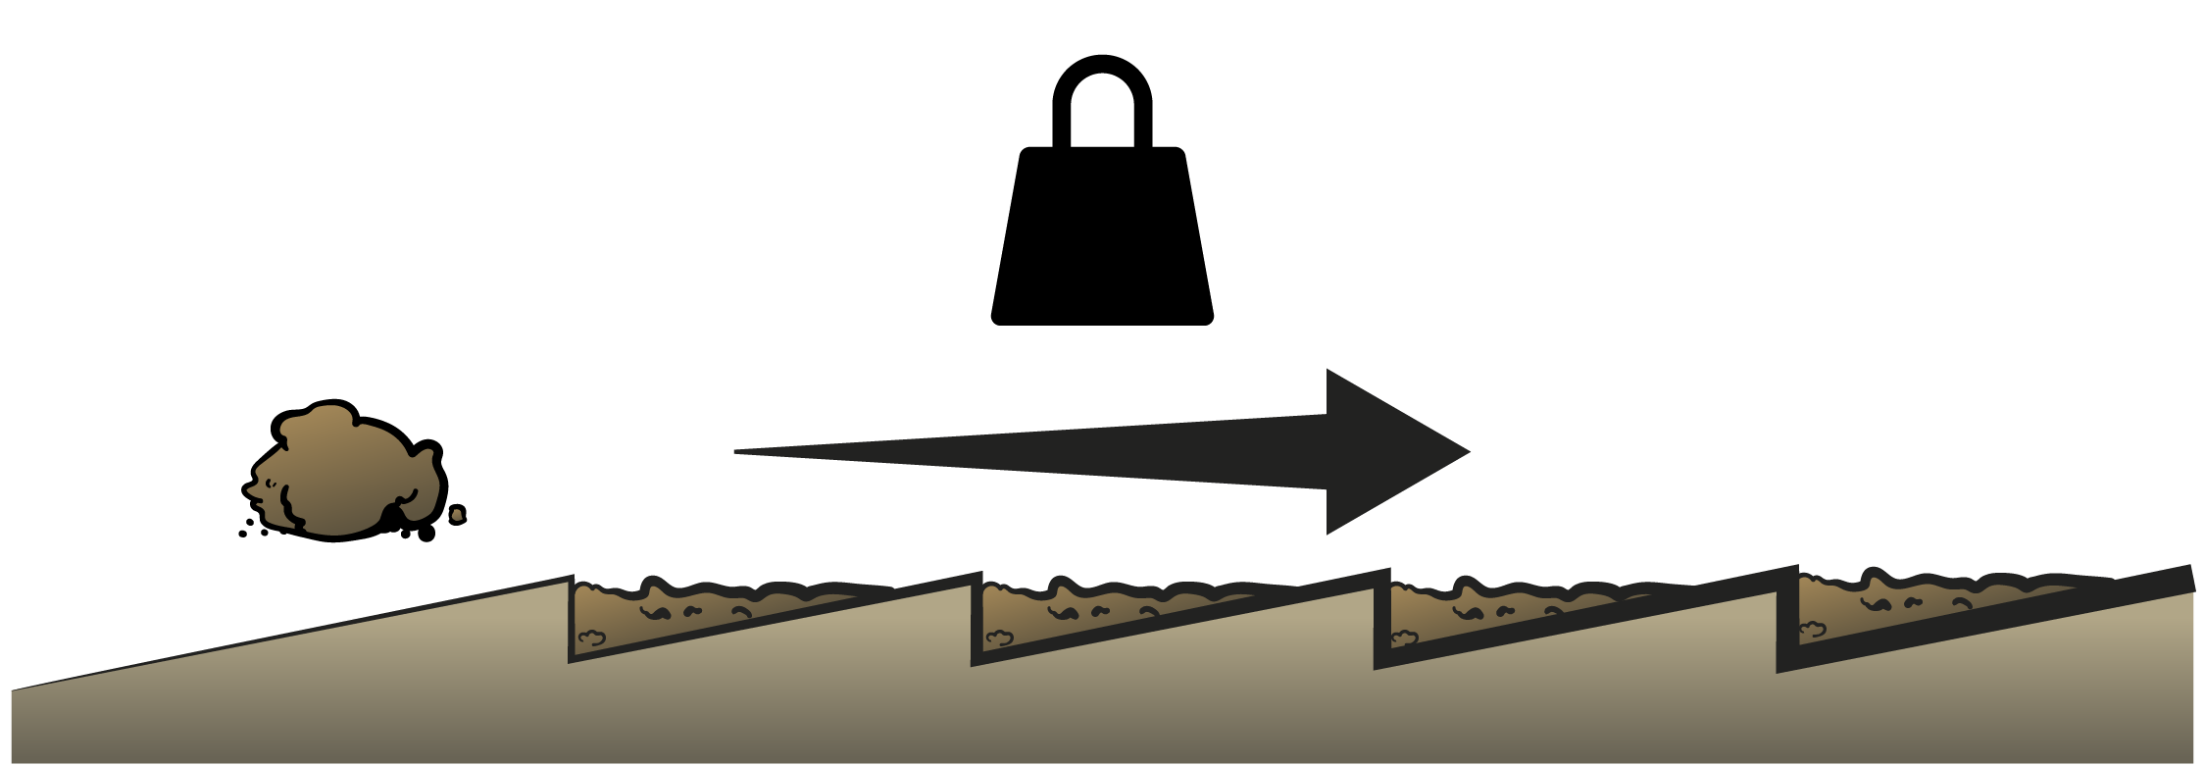
The point shape makes all the difference!
Any ridge in middle of the point will split soil flow, lowering mixing
Ridges upwards + sideways will push some soil to side instead of upwards
Flat surfaces minimizes friction and diesel consumption

Slide 21
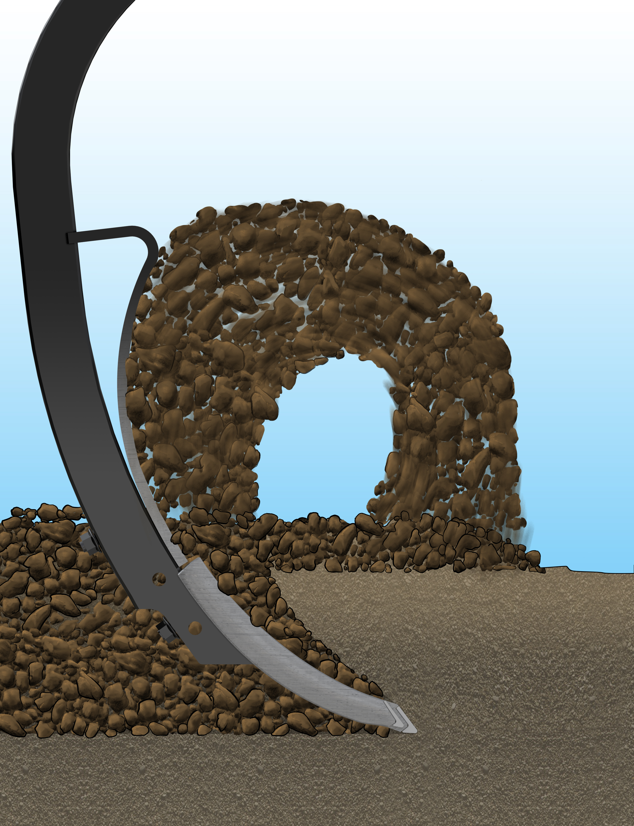

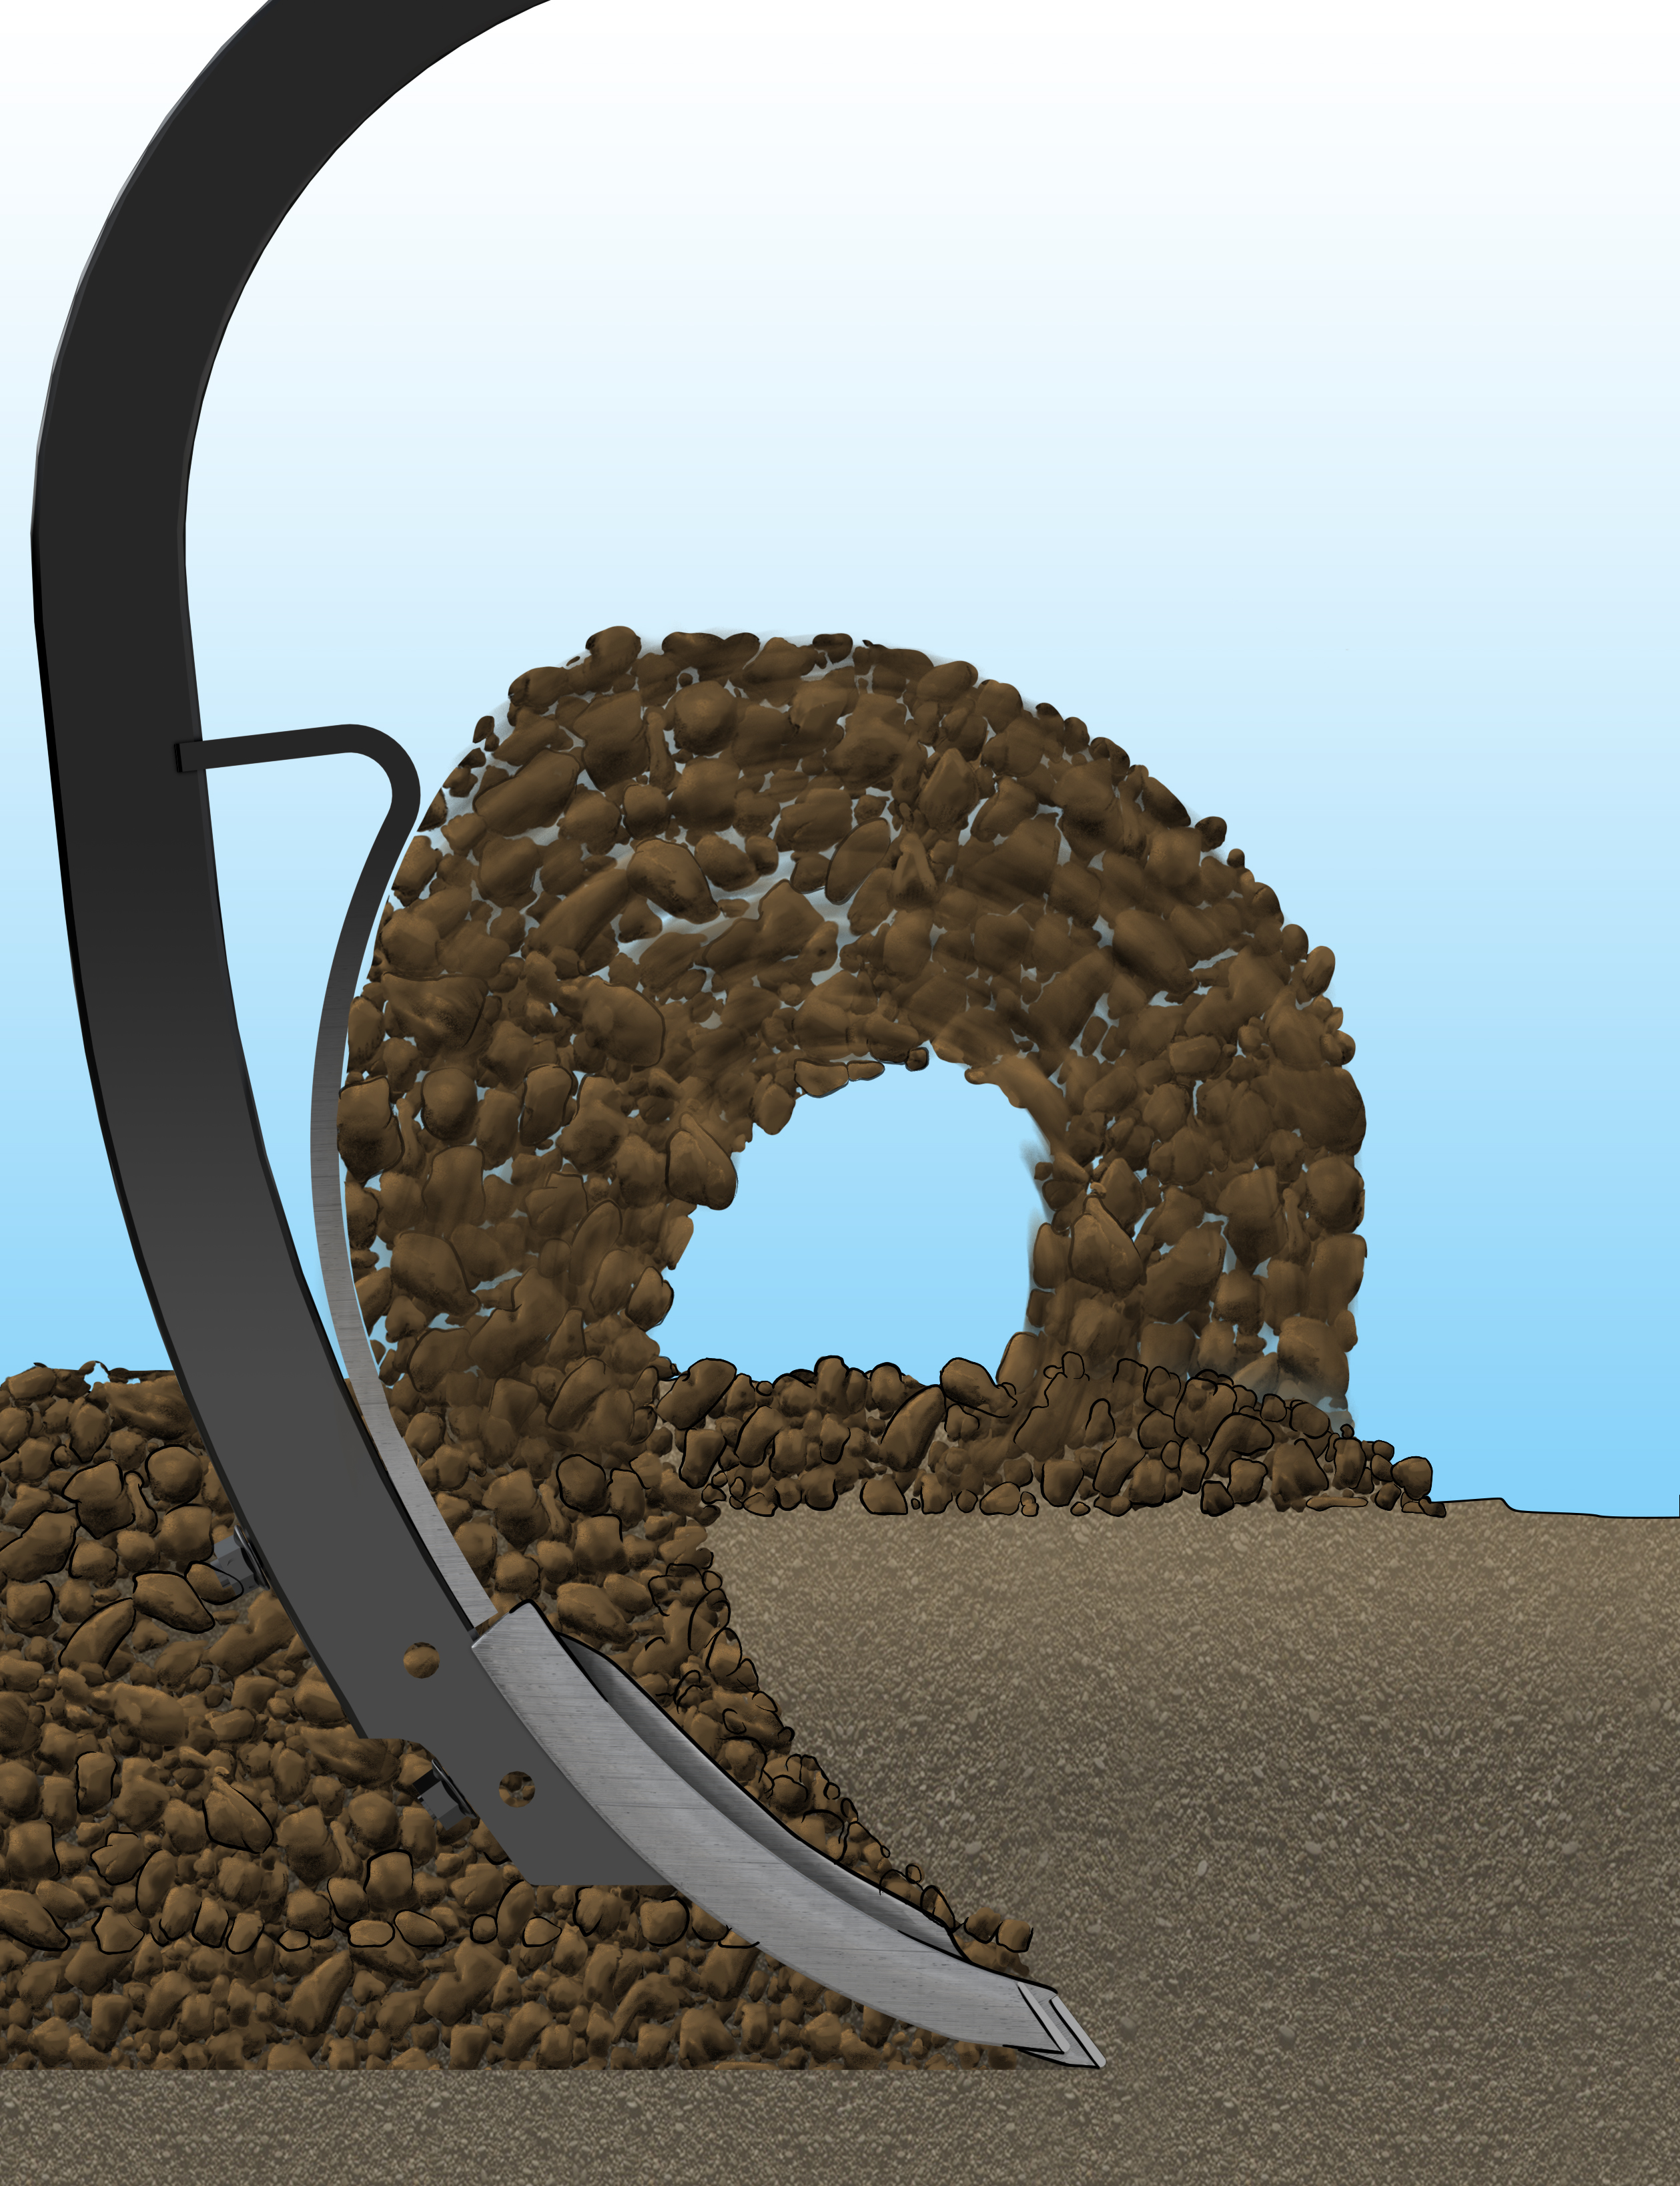
Right shape saves working depth!
Marathon – full mixing
Point with ridge, same depth, reduced mixing
Point with ridge, depth compensation necessary for full mixing result

Slide 22
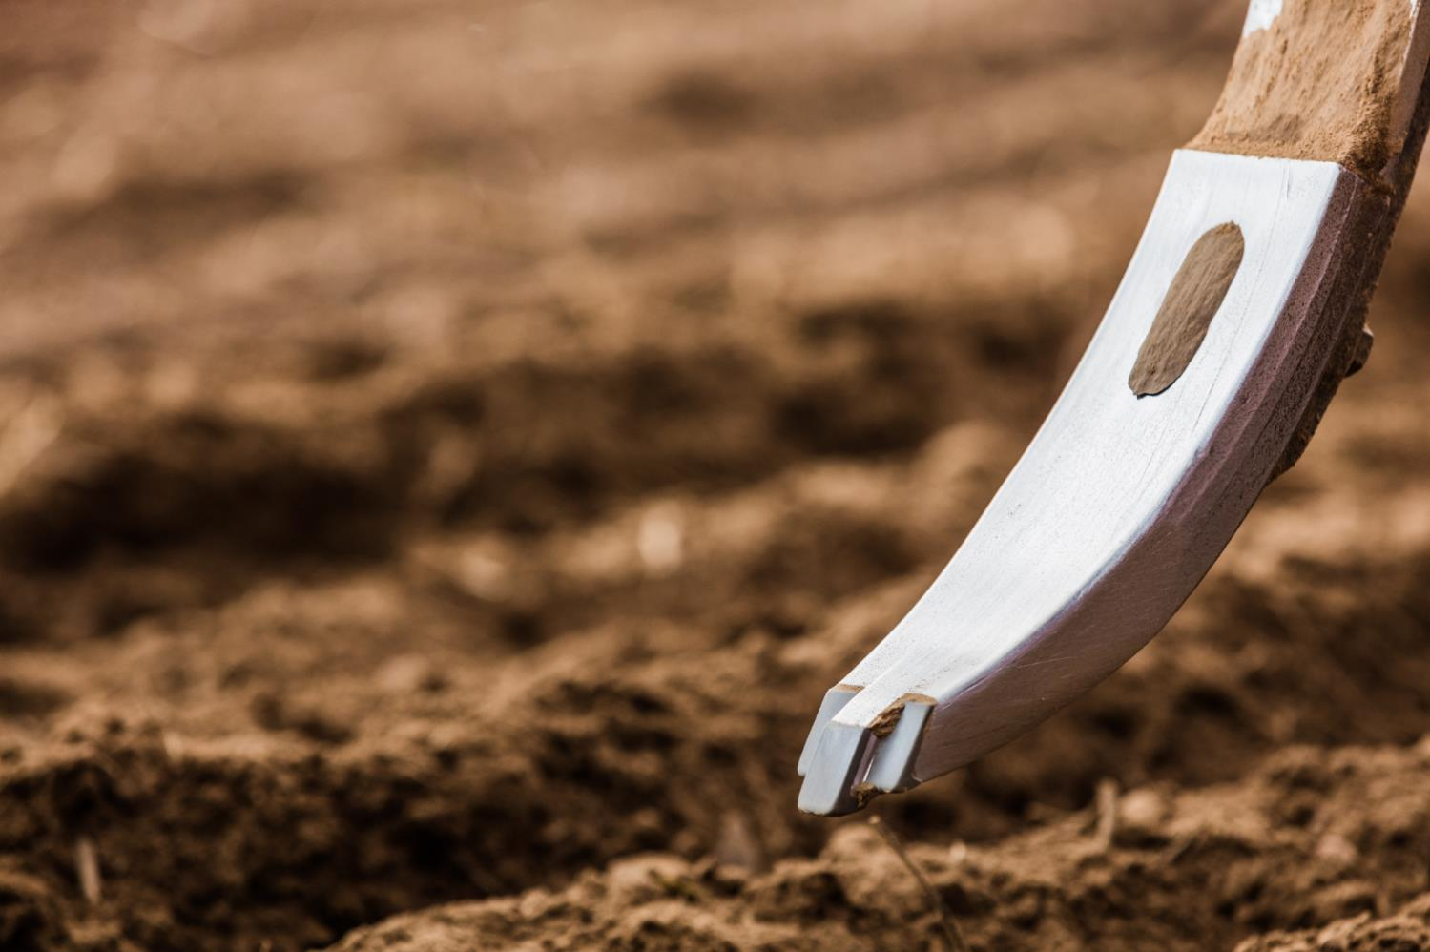
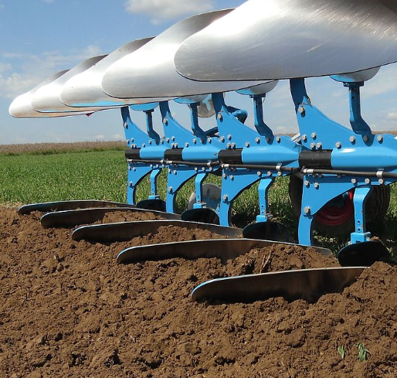
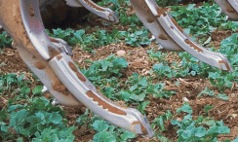
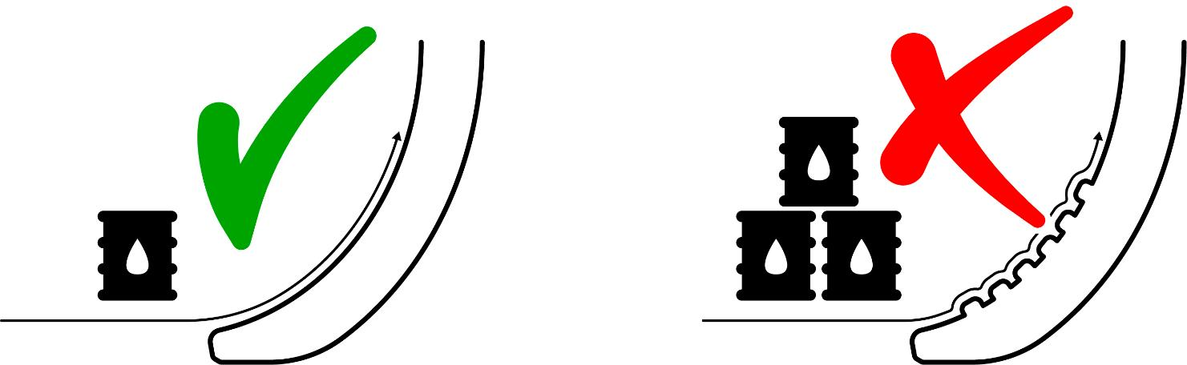
Even point – less fuel needed
Soil against metal, low friction. Compare to plough body
Soil against soil = friction

Slide 23
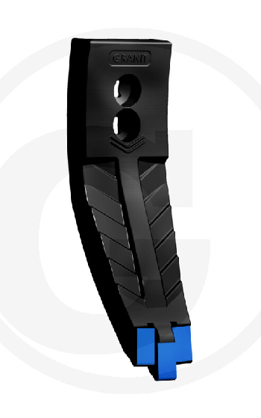
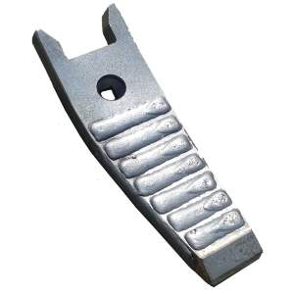
Uneven surfaces – same disadvantages as earlier but intentional…
=

Slide 24
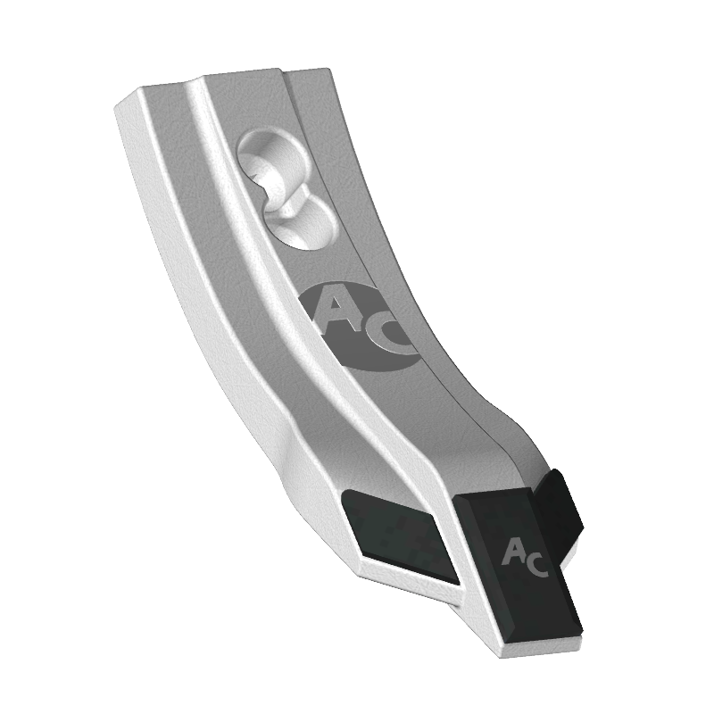
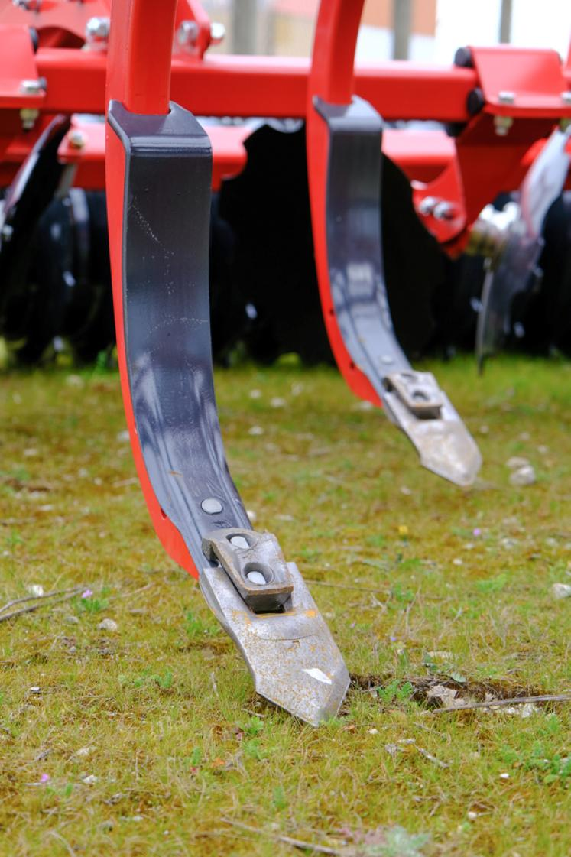
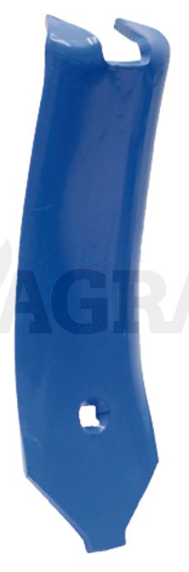
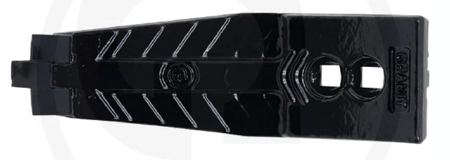
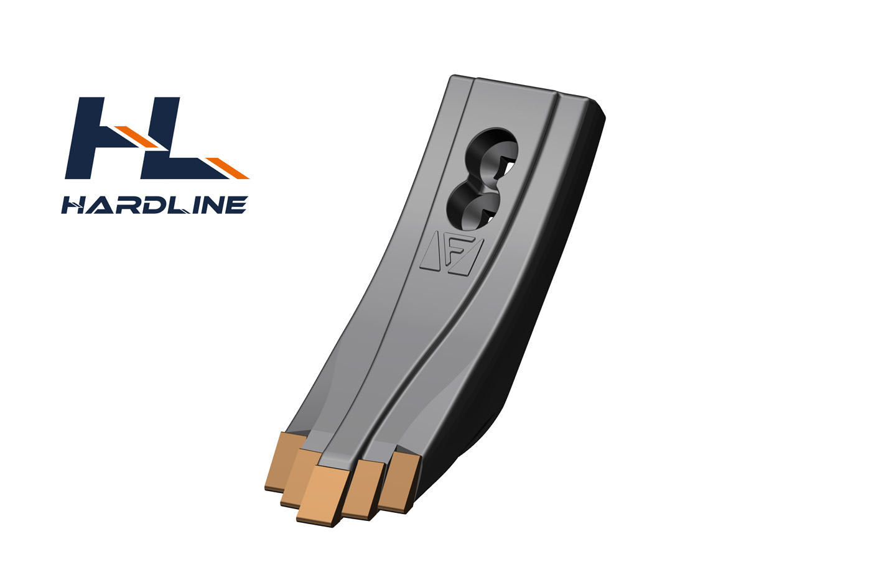
Soil flow requires flat surfaces

Slide 25
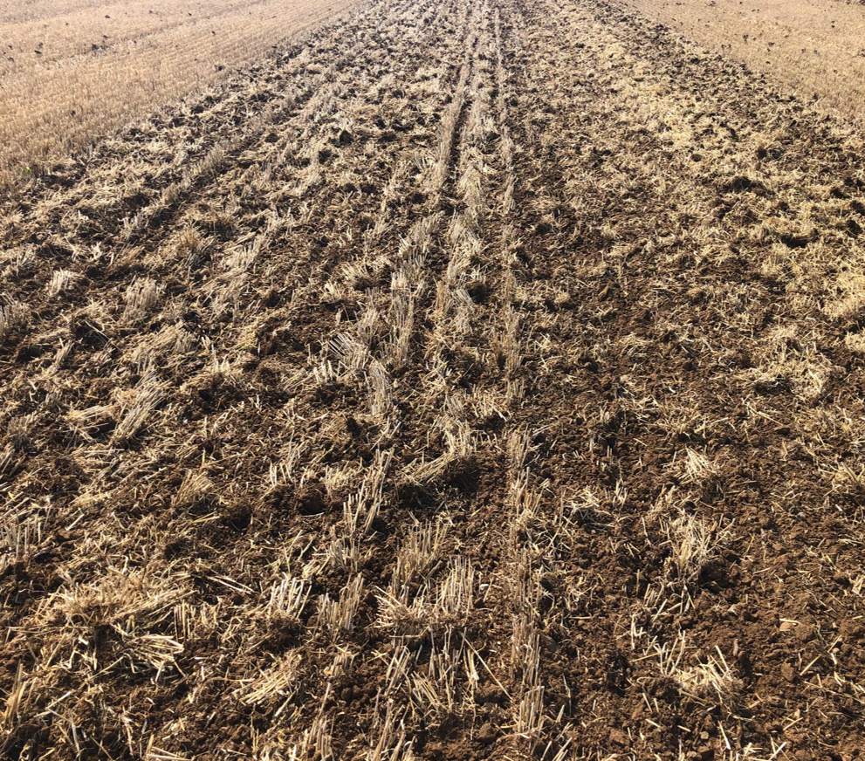
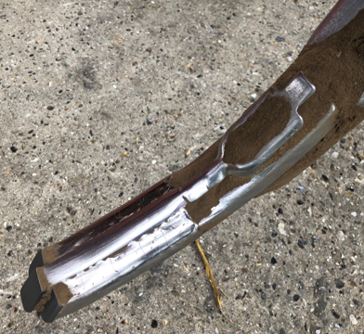
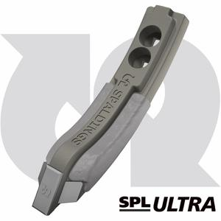
Customer test UK
Shows clearly that points with a thicker center than the sides will split the soil flow and transport soil sideways, this heavily reduces the mixing ability, more like LowDisturbance. The work results suffers.
Industrial, not agronomical focus engineering
Examples
Non genuine Marathon solution
Marathon

Slide 26

Worn ridges = round points
Minimum amount of soil moved upwards

Slide 27


Split or sharp point improves penetration and depth keeping

Slide 28

Better bottom with split point
All points will cause problems in some soils under certain conditions.
These are local compactions/smearings and will act as root barriers as well as preventing water transport.
By splitting the point these damages are minimized since the flat surface with soil contact is kept as small as possible.
Picture source: Hogrefe, Top Agrar 6/2021, pg 80

Slide 29



Angled hard metal -
for stony conditions
Angled hard metal
Fastened in two angles – increases strength
Normal hard metal
Thick hard metal layer – very stable

Slide 30


Angled hard metal increases working life by preventing wear on back side
Forces acting on point
Source: Praxishandbuch Bodenbearbeitung und Aussaat

Slide 31




Made by Väderstad – perfect fit guaranteed!
Correct length bolts for optimal strength
Right diameter bolt holes for perfect fit
Perfect fit to the tine
The right length for optimal mixing result

Slide 32


Ridges keeps the point in place

Slide 33


The time aspect
Points need changing in the middle of the season
Consumes time, effort and costs
The hourly cost may be immense when rain is approaching
More time driving may be crucial some years

Slide 34
The Marathon 50/80mm point
Narrow point increases penetration
Does not pull up clods
Maintained mixing ability

Slide 35


Marathon Edge
Thin, sharp point, enters easier, ensuring penetration in tough conditions
Soil flow similar to standard point
App. 4x working life of normal point
Relativley low weight maximises vibrations in Swift tine. These helps creating fine tilth, sort the soil and minimizing draw force requirement. Heavier points reduces vibrations
Recommended for Väderstad Swift but fits also on other Väderstad cultivators
Marathon Edge compared to standard Marathon 80 mm

Slide 36

Edge family
80 mm
50/80 mm

Slide 37


Edge maintains the working depth over time

Slide 38


Swift – better work result
Sharper edge keeps the depth better

Slide 39


DeepLoosening – a Väderstad unique point
A very cost effective way of subsoiling, saves passes and capital costs
Breaks deep compactions
Increases water uptake capacity in wet regions
Aerates lower horizons starting mineralization freeing nutrients
Works best if residues are well chopped and a stubble preparation has been performed before

Slide 40


DeepLoosening delivers long term
2019 Lithuania tests
1143 ha
1700 ha

Slide 41

Always perfect depth with Marathon
Full seedbed precision over time

Slide 42




Two types of points
TIP
Thin points in front and thick points back on medium heavy soils.
15/25
Thinner, keeps depth better in heavier soils. Adjustable height.
25/35
Wider, more levelling
Light to medium soils heavy soils in the rear.

Slide 43

Marathon – no matter placement in machine

Slide 44

The seedbed depth matters
Marathon no depth wear
Always right seedbed, right seed depth.
Standard worn, high coulter pressure
Seed depth right. Lower temperature, less gas exchange. More sensitivity to wet conditions
Standard worn, lower coulter pressure
Shallow seeding. Warm seedbed, faster germination. Sensitive drought, frost. Less anchoring, more lodged crop.

Slide 45

10x Longer working life ensures excellent economy
6-7 times higher price with 10 times longer working life
Saves plenty of working time, example NZ Aggressive 800 with a switch/turning time of 3h it saves 60 hours throught the working life of a Marathon point where 20 turns are avoided
If purchase price feels high, start year one with first 2-3 rows and use up the final wear steel on the last rows before switching to them

Slide 46
Competitors

Slide 47

Spalding
A higher middle of the point will push soil to the sides reducing the amount of soil that reaches the shin for mixing. This will require a bigger working depth to achieve the same result.
No folded hard metal around the tip, wear from back and higher sensitivity to stones
Same soil to soil design as several competitors – no function, just stops soil flow

Slide 48

Agricarb

Slide 49


Flat hard metal plate!

Slide 50

Brazing better than welding
If this surface was fuel efficient – why isn't a plough body uneven? Same task!
Welding creates friction - HIDDEN COST!

Slide 51

Test result after 920 ha
Length
Weight
Agricarb
Väderstad
Agricarb
Väderstad
A general rule of thumb says that hard metal has a life span of app. 4-5 times of a hard metal welding.

Slide 52

Marathon maintains the working width

Slide 53


Added steel on right spot keeps the width

Slide 54

Comparison field test
Agrocarb
Removed after 1300ha
Marathon
2130ha, still going strong

Slide 55

Frank Original

Slide 56



Short front tooth increases working life
Marathon – perfect wear pattern also after extreme usage (2900 ha)
A copy with long front tooth – wear around point, increases draw force requirement and shortens life time

Slide 57

Flat hard metal plates!

Slide 58


Its all about the back side!
Marathon – hard metal protects back side from wear
Competitors – wear from back side leads hard metal to break

Slide 59




Angled hard metal – increases life time
Conventional hard metal point
Marathon with angled hard metal
Material wear back leads to cracked hard metal
Very little wear back

Slide 60

Wear progress – point width reduced
Very little stone resistance

Slide 61


Forged better than milled
Marathon is fully forged while Frank mills the back of their points
Weakens point elasticity and shortens life time in stony conditions

Slide 62


Slide 63
2020 Marathon comparisons

Slide 64
Test 1
Unirol (Poland), Industriehof, Granit, Agricarb

Slide 65


140 ha
Industriehof shows wear on back, this causes breakages of corners
Marathon – minimal wear

Slide 66
650 ha
Heavy wear on competiors points. Uneven wear with lots of breakages.
Marathon point with wear at carbide and steel, but no breakages.
Granit leaves the race
Agricarb
Marathon
Granit

Slide 67

800 ha
Industriehof is completly at an end (should have been removed earlier), no hard metal left

Slide 68
1150 ha
Most were dismounted due to high wear
Lots of breakages carbide
Marathon still in good condition
Unirol leaves the test completly at an end.
One Marathon and one Agricarb continue with test
Marathon
Unirol

Slide 69
2000 ha
Marathon
Steel body is getting thinner, rounded corners but acceptable for continous service
Agricarb
Massive wear, end of life and problem of residue sticking

Slide 70

Marathon keeps the shape several times longer than most, considerably longer than the best! Higher customer value.

Slide 71

Increasing competition also trying to go around patent of folded hard metal

Slide 72
Test 2
Unirol and Industriehof 80mm
Industriehof
Unirol
Appearance almost identical
Wear on back already after 130ha on both competitors – folded hard metal pays off!
Unirol has triangular hard metal

Slide 73



450 ha
1000 ha
Marthon
Unirol
Competitor points dismounted earlier by customer due to breakages and less optimal work result. Marathon kept until 3000ha test end. Double life time!
Marthon
Industriehof

Slide 74


2021 September Marathon vs Granit Endurance
Granit Endurance points removed after 1350ha.
The middle of the point has gotten too thin ”waist syndrome”, too little mixing. Ridge in middle possible cause pushing soil outwards.
The point had worn out in the middle, only little material left, risk of breakage and point loss
Not a proper distribution of material vs hard metal
All Marathon points were kept on the machine
Text on point is error, should be 1350ha

Slide 75




Väderstad 2021 test
Marathon vs Granit Endurance (504ha)
Agronomy first!
Any ridges of the point will act as a soil flow splitter, this brings less soil to the shin, mixing ability is reduced!
Any uneveness on the point breaks the soil flow unecessary and will lead to more fuel consumtion. Design without knowledge about function!

Slide 76


Harder steel – longer working life
Promise Granit: 46 HRC, actual very uneven 37-39…
Väderstad: Very even 50 HRC

Slide 77

Less metal lost with Marathon

Slide 78


Length of carbide better
All but one case Väderstad has a lot less length loss
Less rounded corners on Marathon points
Maintained shape is maintained work result

